Slide 1
AI/ML Professional Training Program: INNOQUEST Cohort-1
1
Instructor
Salma Asif
Department of Computer Science
FAST National University of Computer and Emerging Sciences
AI/ML Professional Training Program: INNOQUEST COHORT-1
Instructor: Salma Asif

Slide 2
Contents
PyTorch
Introduction
Pytorch installation
Tensors
Creating Parameters
Dynamic Computation Graph
Autograd
Optimizers
Loss Functions
Model Class
A Simple Regression Problem (Pytorch Implementation)
AI/ML Professional Training Program: INNOQUEST COHORT-1
Instructor: Salma Asif

Slide 3

PyTorch is a deep learning framework and scientific computing package based on Python that uses the power of graphics processing units (GPU)
Primarily developed by Facebook’s AI Research lab (FAIR)
PyTorch was launched in October of 2016 as Torch
A number of Deep Learning solutions are are built on top of PyTorch, including:
Tesla Autopilot.
Uber’s Pyro.
HuggingFace’s Transformers.
AI/ML Professional Training Program: INNOQUEST COHORT-1
Instructor: Salma Asif
Notes:
FROM RESEARCH TO PRODUCTION
– An open source machine learning framework that accelerates the path from research prototyping to production deployment

Slide 4
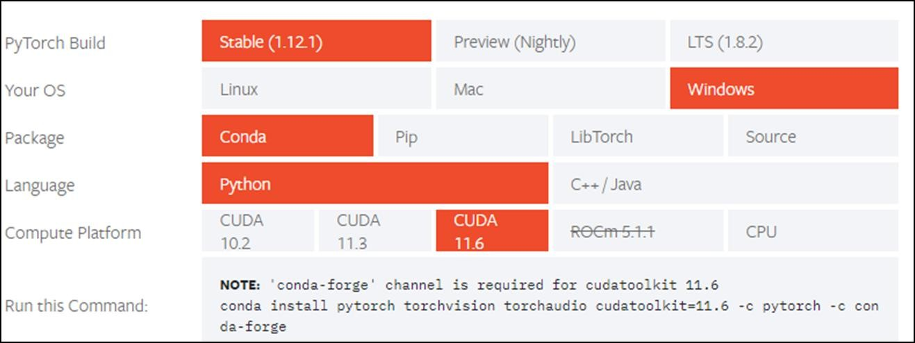
Installing in Anaconda Environment
https://pytorch.org/

Slide 5

The elements we should get to know when starting out with PyTorch are:
PyTorch Tensors
Mathematical Operations
Autograd module
Optim module and
nn module : Layers and Tools to easily create a neural networks by just defining the layers of the network.
AI/ML Professional Training Program: INNOQUEST COHORT-1
Instructor: Salma Asif

Slide 6
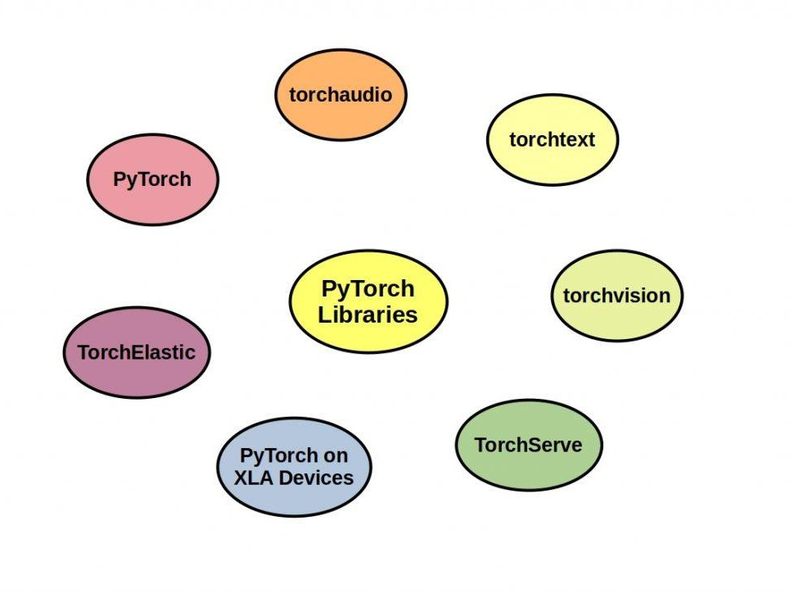
PyTorch libraries
AI/ML Professional Training Program: INNOQUEST COHORT-1
Instructor: Salma Asif

Slide 7
TENSORS

Slide 8
Tensors
Multi-dimensional array
Tensors in PyTorch are similar to NumPy’s arrays,
Scalar (a single number) has zero dimensions
Vector has one dimension
Matrix has two dimensions
Tensor has three or more dimensions
AI/ML Professional Training Program: INNOQUEST COHORT-1
Instructor: Salma Asif
Notes:
tensors are optimized for automatic differentiation and can run on GPUs.
But, to keep things simple, it is commonplace to call vectors and matrices tensors as well
so, from now on, everything is either a scalar or a tensor

Slide 9
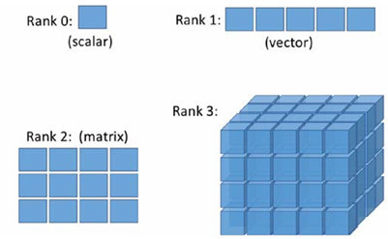
Tensors
Different types of tensors in Pytorch
AI/ML Professional Training Program: INNOQUEST COHORT-1
Instructor: Salma Asif

Slide 10

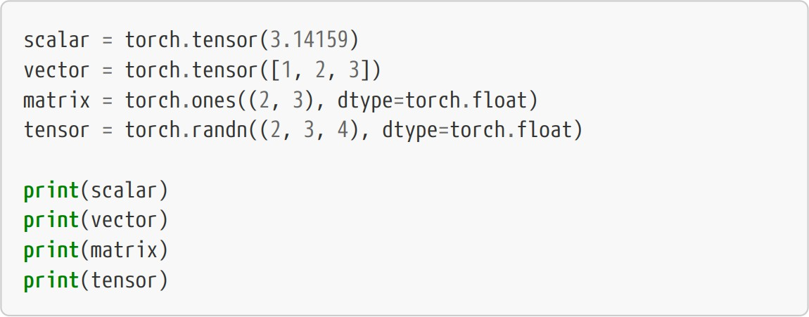
Creating Tensors
AI/ML Professional Training Program: INNOQUEST COHORT-1
Instructor: Salma Asif
Notes:
You can create tensors in PyTorch pretty much the same way you create arrays in Numpy. Using tensor() you can create either a scalar or a tensor.
PyTorch’s tensors have equivalent functions as its Numpy counterparts, like: ones(), zeros(), rand(), randn() and many more.

Slide 11
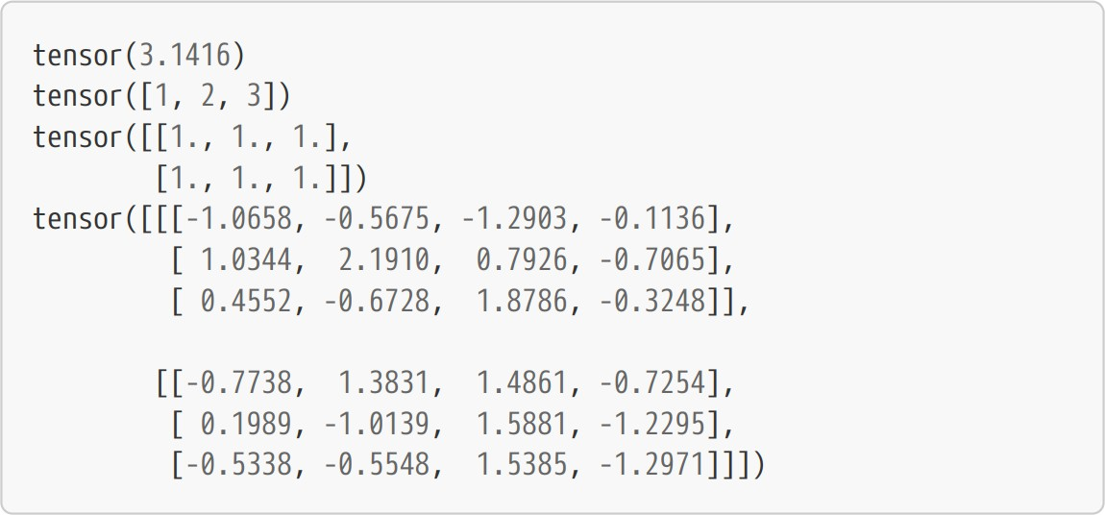
Creating Tensors
AI/ML Professional Training Program: INNOQUEST COHORT-1
Instructor: Salma Asif

Slide 12


Getting Shape of Tensor
AI/ML Professional Training Program: INNOQUEST COHORT-1
Instructor: Salma Asif
Notes:
You can get the shape of a tensor using its size() method or its shape attribute.
All tensors have shapes, but scalars have "empty" shapes, since they are dimensionless (or zero dimensions):

Slide 13
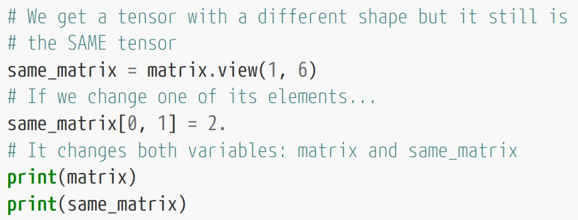
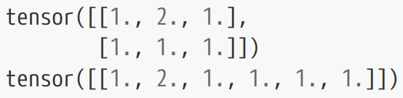
Reshaping a Tensor
You can also reshape a tensor using its view() (preferred) or
reshape() methods
Beware it DOES NOT create a new, independent, tensor!

Slide 14
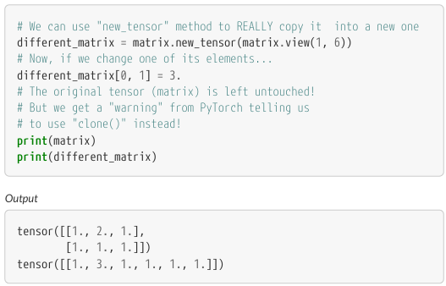
Copying a Tensor
If you want to copy all data for real, that is, duplicate the data in
memory, you may
use either its new_tensor() or clone() methods

Slide 15
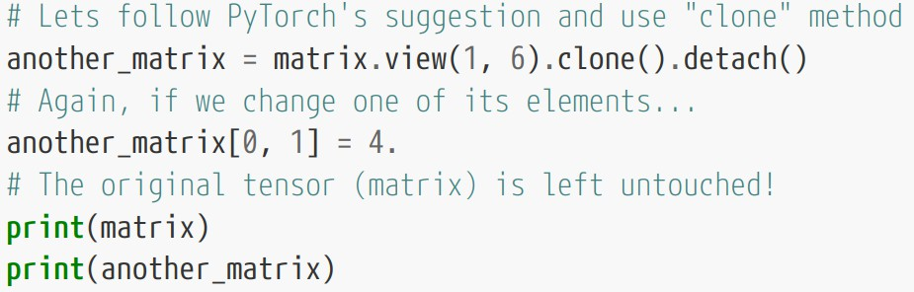
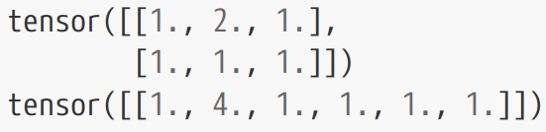
Copying a Tensor
If you want to copy all data for real, that is, duplicate the data in
memory, you may
use either its new_tensor() or clone() methods

Slide 16

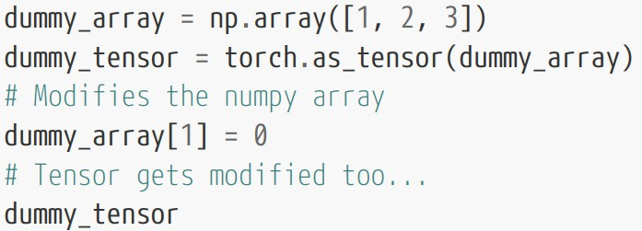

Numpy to PyTorch
as_tensor() or from_numpy() is used to convert Numpy arrays to PyTorch Tensors
This operation preserves the type of the array
both as_tensor() and from_numpy() return a tensor that shares the underlying data with the original Numpy array.
torch.tensor() always makes a copy of Numpy array
the data
Notes:
It is time to start converting our Numpy code to PyTorch: we’ll start with the training data, that is, our x_train and y_train arrays.

Slide 17


PyTorch to Numpy
You can also perform the opposite operation, namely, transforming a PyTorch tensor back to a Numpy array. That’s what numpy() is good for:
Notes:
So far, we have only created CPU tensors. What does it mean? It means the data in the tensor is stored in the computer’s main memory and any operations performed on it are going to be handled by its CPU (the Central Processing Unit, for instance, an Intel® Core™ i7 Processor). So, although the data is, technically speaking, in the memory, we’re still calling this kind of tensor a CPU tensor

Slide 18
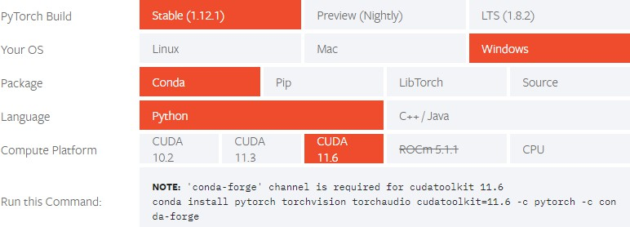
GPU Tensors
These tensors store their data in the graphics card’s memory
Operations on top of them are performed by the GPU
If you have a graphics card from NVIDIA, you can use the power of its GPU
to speed up model training.
PyTorch supports the use of these GPUs for model training using CUDA (Compute Unified Device Architecture), which needs to be previously installed and configured
Notes:
A GPU (which stands for Graphics Processing Unit) is the processor of a graphics card.

Slide 19

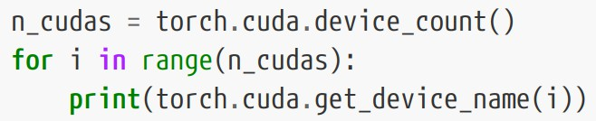

GPU Tensors
you should always make your code GPU-ready,
that is, it should automatically run in a GPU, if one is available
Notes:
if you don’t have a GPU, your device is called cpu. If you do have a GPU, your device is called cuda or cuda:0.

Slide 20

GPU Tensors
Moving tensor to GPU using .to()
AI/ML Professional Training Program: INNOQUEST COHORT-1
Instructor: Salma Asif
Notes:
There is only one thing left to do: turn our tensor into a GPU tensor. That’s what to() is good for. It sends a tensor to the specified device.
Should I use to(device), even if I am using CPU only.
Yes, you should, because there is no cost in doing so. If you have only a CPU, your tensor is already a CPU tensor, so nothing will happen. But if you share your code with others on GitHub, whoever has a GPU will benefit from it.

Slide 21
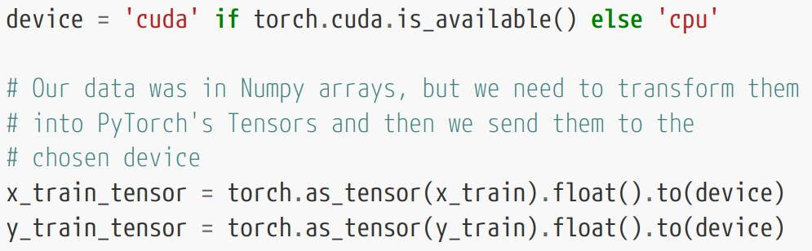
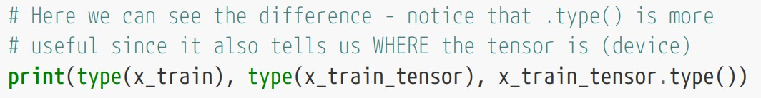

Putting it all together
Notes:
If you compare the types of both variables, you’ll get what you’d expect: numpy.ndarray for the first one and torch.Tensor for the second one. But where does the x_train_tensor “live”? Is it a CPU or a GPU tensor? You can’t say… but if you use PyTorch’s type(), it will reveal its location torch.cuda.FloatTensor — a GPU tensor in this case (assuming the output using a GPU, of course).

Slide 22



GPU Tensors to Numpy
AI/ML Professional Training Program: INNOQUEST COHORT-1
Instructor: Salma Asif
Notes:
There is one more thing to be aware of when using GPU tensors… remember numpy()? What if we want to turn a GPU tensor back into a Numpy array? We’ll get an error
Unfortunately, Numpy cannot handle GPU tensors… you need to make them CPU tensors first using cpu()
So, to avoid this error, use first cpu() and then numpy(), even if you are using a CPU.

Slide 23
Mathematical operations
more than 200+ mathematical operations
torch.add()
torch.sub()
Torch.mul()
Torch.div()
torch. mean(),
torch.std()
AI/ML Professional Training Program: INNOQUEST COHORT-1
Instructor: Salma Asif

Slide 24
Slicing, Stack, and Concatenate Tensors
Slicing is a technique used to extract specific portions of a tensor
x[:, 0]
Stack
torch.stack()
Concatenate
torch.cat()
AI/ML Professional Training Program: INNOQUEST COHORT-1
Instructor: Salma Asif
Notes:
Sometimes, we are working with multiple tensors and need to concatenate or stack them to create a single tensor.

Slide 25
Creating Parameters
What is difference between a tensor used for training (validation or test) data and a tensor used for the parameter/weight of NN?
Parameters requires computation of gradients with respect to a loss function during training
A tensor for a learnable parameter requires a
gradient!
Always assign tensors to a device at the moment of their creation to avoid unexpected behaviors!
AI/ML Professional Training Program: INNOQUEST COHORT-1
Instructor: Salma Asif

Slide 26
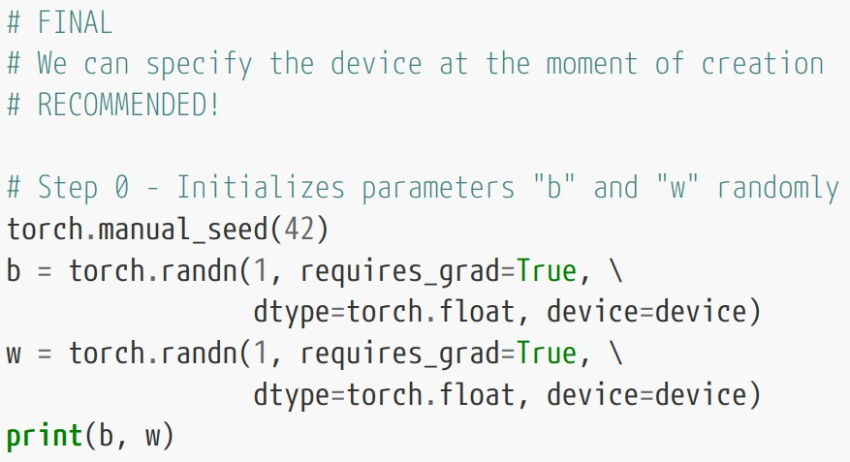

Creating Parameters
Notes:
"If I use the same seed in PyTorch as I used in Numpy (or, to put it differently, if I use 42 everywhere), will I get the same numbers?“
Unfortunately, NO. You’ll get the same numbers for the same seed in the same package. PyTorch generates a number sequence that is different from the one generated by Numpy, even if you use the same seed in both
we can do better: we can assign tensors to a device at the moment of their creation

Slide 27
DYNAMIC COMPUTATION GRAPH

Slide 28
Computation Graph (Chain Rule)
Computational graphs are a type of graph that can be used to represent mathematical expressions
These can be used for two different types of calculations:
Forward computation
Backward computation
Static Vs Dynamic Computation Graph
AI/ML Professional Training Program: INNOQUEST COHORT-1
Instructor: Salma Asif

Slide 29
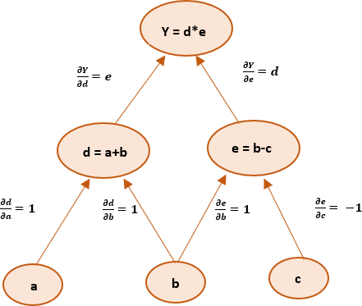
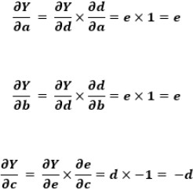
Example

Slide 30
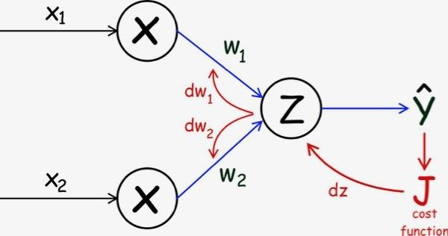
Computation Graph (Chain Rule)
𝑦ො = 𝑧 = 𝑥₁𝑤₁ + 𝑥₂𝑤₂
𝜕𝐽 𝜕𝐽 𝜕z
𝑑𝑤 = = ∗
𝜕𝑤 𝜕𝑧 𝜕𝑤
𝐽 = 𝑓(𝑧, 𝑦)
AI/ML Professional Training Program: INNOQUEST COHORT-1
Instructor: Salma Asif

Slide 31
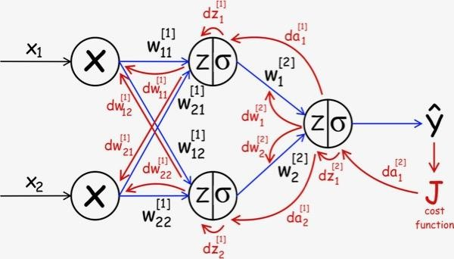
Computation Graph (Chain Rule)
AI/ML Professional Training Program: INNOQUEST COHORT-1
Instructor: Salma Asif

Slide 32

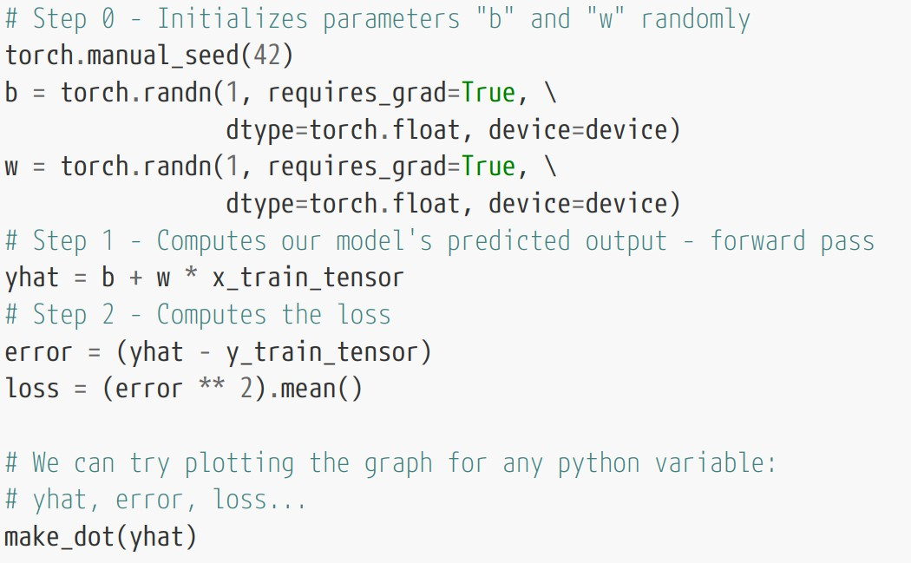
PyTorch Computation Graph
You have to see it for yourself
The PyTorchViz package and its make_dot(variable)

Slide 33
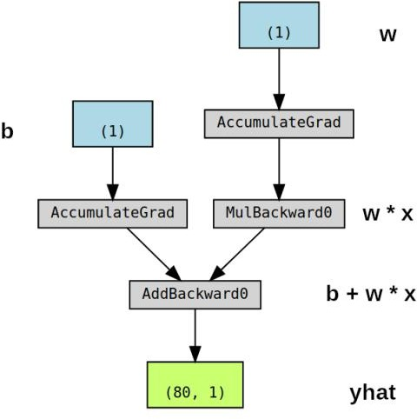
PyTorch Computation Graph
Where is X?
AI/ML Professional Training Program: INNOQUEST COHORT-1
Instructor: Salma Asif
Notes:
• blue boxes ((1)s): these boxes correspond to the tensors we use as parameters, the ones we’re asking PyTorch to compute gradients for
• gray boxes (MulBackward0 and AddBackward0): a Python operation that involves a gradient-computing tensor or its dependencies
• green box ((80, 1)): the tensor used as the starting point for the computation of gradients (assuming the backward() method is called from the variable used to visualize the graph) — they are computed from the bottom-up in a graph

Slide 34
AUTOGRAD

Slide 35
Autograd
Autograd is PyTorch’s automatic differentiation package.
Thanks to it, we don’t need to worry about partial derivatives, chain rule, or anything like it.
Role of the backward() method
It will compute gradients for all (requiring gradient) tensors involved
in the computation of a given variable
Do you remember the starting point for computing the gradients?
loss.backward()
AI/ML Professional Training Program: INNOQUEST COHORT-1
Instructor: Salma Asif
Notes:
how do we tell PyTorch to do its thing and compute all gradients? That’s the role of the backward() method.
Do you remember the starting point for computing the gradients? It was the loss, as we computed its partial derivatives w.r.t. our parameters. Hence, we need to invoke the backward() method from the corresponding Python variable: loss.backward().

Slide 36




Autograd in Action
Which tensors are going to be handled by the backward() method applied to the loss?
AI/ML Professional Training Program: INNOQUEST COHORT-1
Instructor: Salma Asif

Slide 37
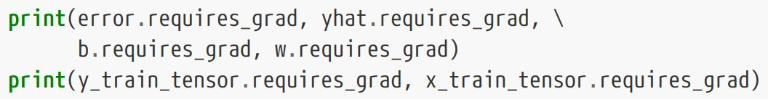
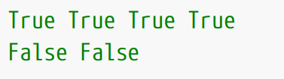
Autograd in Action

Slide 38


grad
What about the actual values of the gradients? We can inspect them by looking at the grad attribute of a tensor.
AI/ML Professional Training Program: INNOQUEST COHORT-1
Instructor: Salma Asif

Slide 39

Gradient Accumulation
If you check the method’s documentation, it clearly states that gradients are accumulated
Why?
If we run above code twice and check the grad attribute afterward
AI/ML Professional Training Program: INNOQUEST COHORT-1
Instructor: Salma Asif

Slide 40

Zeroing Accumulation
Every time we use the gradients to update the parameters, we need to zero the gradients
afterward. And that’s what zero_() is good for
AI/ML Professional Training Program: INNOQUEST COHORT-1
Instructor: Salma Asif

Slide 41
OPTIMIZERS

Slide 42
Optimizer
We’ve been manually updating the parameters using the computed gradients so far
What if we had a whole lot of parameters?!
We need to use one of PyTorch’s optimizers, like
SGD, RMSprop, or Adam.
SGD is the most basic of them, and Adam is one of the most popular.
Different optimizers use different mechanics for updating the parameters, but they all achieve the same goal through, literally, different paths
AI/ML Professional Training Program: INNOQUEST COHORT-1
Instructor: Salma Asif

Slide 43
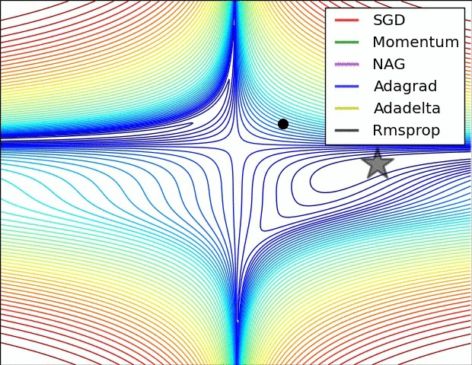
Optimizer
Remember, the choice of mini-batch size influences the path of gradient
63
descent, and so does the choice of an optimizer

Slide 44

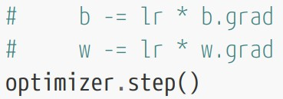
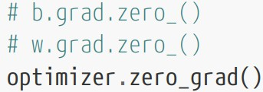
Optimizer (step / zero_grad)
An optimizer takes the parameters we want to update, the learning rate we want to use (and possibly many other hyper- parameters as well!), and performs the updates through its step() method
AI/ML Professional Training Program: INNOQUEST COHORT-1
Instructor: Salma Asif

Slide 45
LOSS FUNCTIONS IN PYTORCH

Slide 46

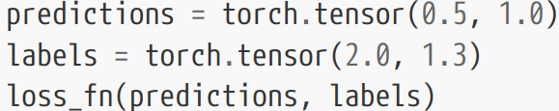

Loss functions in PyTorch
PyTorch got us covered with many loss functions to choose from, depending on the task at hand.
Since ours is a regression, we are using the Mean Squared Error (MSE) as loss, and thus we need PyTorch’s nn.MSELoss

Slide 47
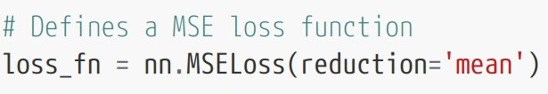

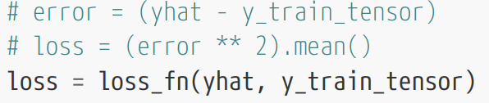

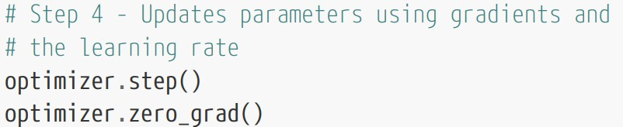

Loss functions in PyTorch

Slide 48
PYTORCH MODEL

Slide 49
Model Class
Are you comfortable with object-oriented
programming constructors, attributes?
(OOP) concepts like
classes,
methods, instances, and
https://realpython.com/python3-object-oriented- programming/
Having a good understanding of OOP is key to benefit the most from PyTorch’s capabilities.
AI/ML Professional Training Program: INNOQUEST COHORT-1
Instructor: Salma Asif

Slide 50
Model Class Parts
Must inherit from nn.Module
init (self):
it defines the parts that make up the model
In our case, two parameters, b and w.
You are not limited to defining parameters, though… models can contain other models as their attributes as well, so you can easily
nest them. We’ll see an example of this shortly as well
Do not forget to include super(). init () to execute the init () method of the parent class (nn.Module) before your own
AI/ML Professional Training Program: INNOQUEST COHORT-1
Instructor: Salma Asif
Notes:
In PyTorch, a model is represented by a regular Python class that inherits from the Module class.

Slide 51
Model Class Parts
forward(self, x):
It performs the actual computation, that is, it outputs a prediction, given the input x
We use model(x) instead of forward(x)
AI/ML Professional Training Program: INNOQUEST COHORT-1
Instructor: Salma Asif

Slide 52
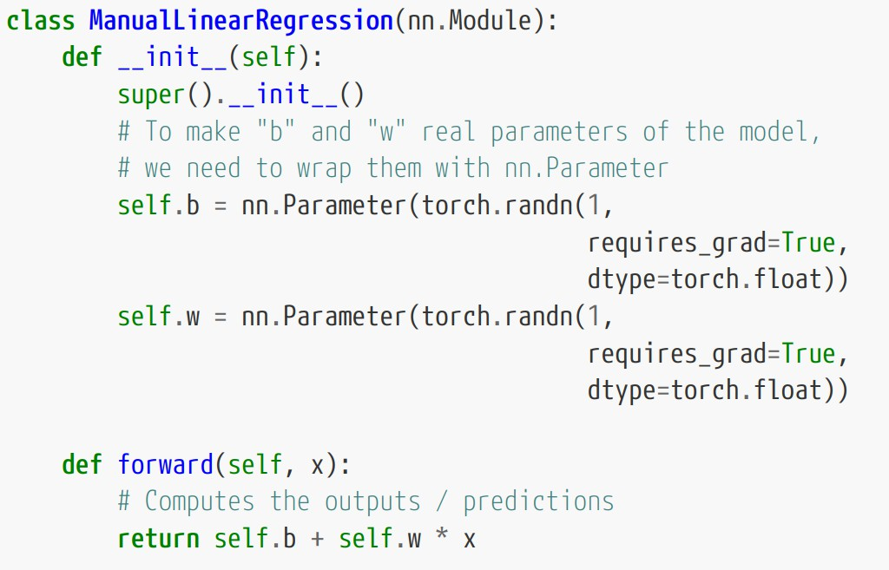
Our Regression Model

Slide 53
Model Parameters
We define our two parameters, b and w, using the Parameter() class
This tells PyTorch that these tensors, which are attributes of the ManualLinearRegression class, should be considered parameters of the model
we can use our model’s parameters() method to retrieve an iterator over all model’s parameters
we can use it to feed our optimizer (instead of building a list of parameters ourselves!)
AI/ML Professional Training Program: INNOQUEST COHORT-1
Instructor: Salma Asif

Slide 54

Model state_dict
We can get the current values of all parameters using our model’s state_dict() method
Only learnable parameters are included, as its purpose is to keep track of parameters
AI/ML Professional Training Program: INNOQUEST COHORT-1
Instructor: Salma Asif

Slide 55
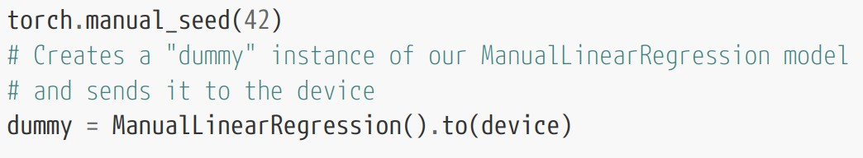
Model Device
We need to send our model to the same device where data is
– If our data is made of GPU tensors, our model must “live” inside the GPU as well
AI/ML Professional Training Program: INNOQUEST COHORT-1
Instructor: Salma Asif

Slide 56
A SIMPLE REGRESSION PROBLEM (PYTORCH IMPLEMENTATION)

Slide 57

Imports, Device, Seed
AI/ML Professional Training Program: INNOQUEST COHORT-1
Instructor: Salma Asif

Slide 58
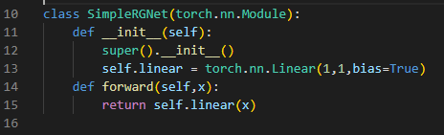
Model Class
AI/ML Professional Training Program: INNOQUEST COHORT-1
Instructor: Salma Asif

Slide 59
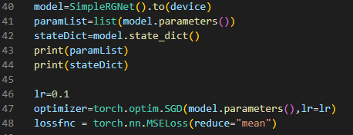
Model, optimizer and loss initialization
AI/ML Professional Training Program: INNOQUEST COHORT-1
Instructor: Salma Asif

Slide 60
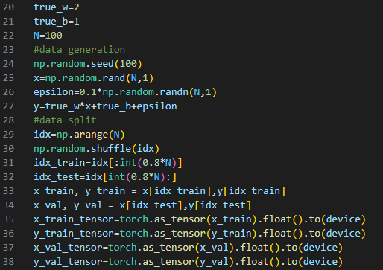
Data Preparation
AI/ML Professional Training Program: INNOQUEST COHORT-1
Instructor: Salma Asif

Slide 61
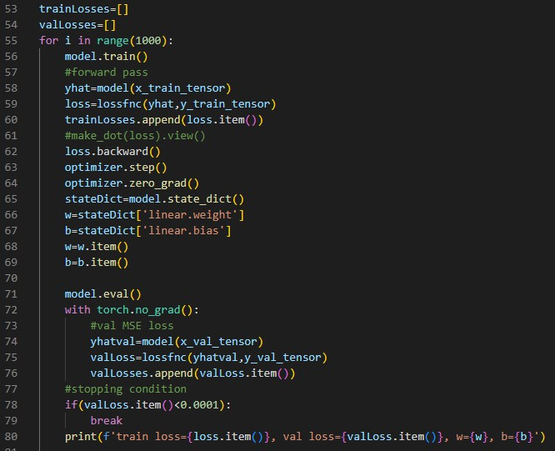
Training Loop

Slide 62
References
Machine Learning with PyTorch and Scikit-Learn (Sebastian Raschka, Yuxi Liu, Vahid Mirjalili)
Deep learning with Pytorch step by step A begineer’s guide (Daniel Voigt Godoy)
https://www.analyticsvidhya.com/blog/2018/02/pytorch-tutorial/
Patrick Loeber (Pytorch tutorial )
Dr. Adeel Lectures
AI/ML Professional Training Program: INNOQUEST COHORT-1
Instructor: Salma Asif

Slide 63
Thank You

